Slide 1
ONLINE PROJECT MANAGEMENT SYSTEM
PRESENTED BY GROUP NO. 55
SHREYAS BHARDWAJ 20171CSE0652
SIDDHANT OJHA 20171CSE0659
SIDHI M KATARIA 20171CSE0661
PAVAN J S 20171CSE0256

Slide 2
PROBLEM STATEMENT
The problems arises from the manual system used at the university that is it
has no record about the time the student handed over their project.
Some of the project elements such as synopsis/reports are lost after the submission.
It is difficult to maintain and review the status of a project manually.
The lecturer does not know whether all of his or her student have submitted their
project because there are lots of projects to be collected.

Slide 3
LITERATURE SURVEY
Currently as of now there are not many colleges which are using these systems for project management and most of the companies and offices we know use such systems to manage all the documentation of project, reports etc.
Similarly we are making this system specifically for universities and colleges so that it could help both the faculty and student if this system turns automated.

Slide 4
OBJECTIVES AND SCOPE
The main purpose of this project is to reduce the paper work and document the progress of the student while he/she is completing the task assigned by the teacher .Students will have a deadline to complete their tasks hence reducing last minute project work and being uniform throughout the course of completing the project on time.
Product Functions
>Creating project milestones/tasks.
>Document everything.
>Keep track of all the student’s progress in project.
>Uploading more than one file for a single task.
>Calculation of status with different colors.

Slide 5
OBJECTIVES AND SCOPE
User Classes and Characteristics
Following are the users of the system:
Admin :Admin is responsible registering student and teacher details by providing them with unique username and password and then assign students under a teacher of the same department.
Teacher: He/she will login with the unique user id and password provided by the admin and add task list for students under him/her. Teacher can view the files uploaded by the students in order to complete the task assigned and can also see student’s status.
Student: Student can view the task list assigned to him and upload files according to the tasks and also view his/her status of project completion

Slide 6
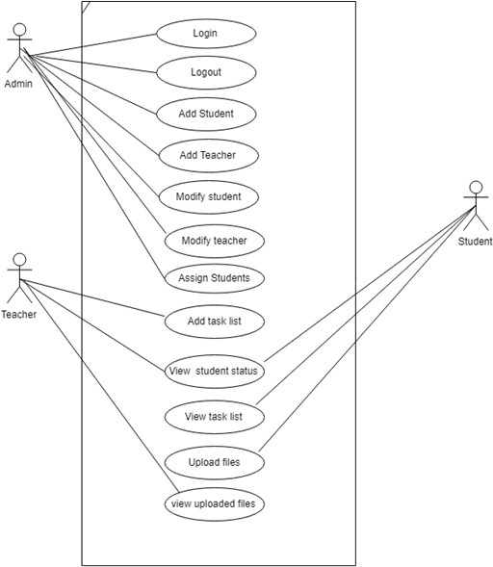
USE CASE DIAGRAM
The use case diagram of Online Project management system is representation of user interaction with the system. It represents user's interaction with the system that shows the relationship between the user and the different use cases in which the user is involved.
Notes:
3.1 Register student and teacher: Admin adds student’s and teacher’s information.Such as first name,last name,address,sex,department,unique userid and password ,salary,phone number etc.
3.2 View students and teachers:Admin can view all the registered students by him.her.
3.3Modify or delete student teacher information:Admin can modify or delete particular student or teacher.
3.4 Assign Students:Admin assigns students under teacher of the same department as their project guide.
3.5 Add task list:Teacher can add tasks by giving description,last date of submission and percentage of weightage of that particular task.
3.6 File uploads:Student can complete his task by uploading files and teacher can view those files uploaded.
3.7 Status bar:If student uploads his files for a particular task on or before the last date,the progress is increased in green colour,if the tasks are pending,it shows in yellow colour and if submitted after the due date,it shows in red.

Slide 7
TECHNOLOGY IDENTIFICATION
Software Requirements
> WAMP Server
> Text editor: Sublime text.
> Web browser: chrome.
Hardware Requirements:
RAM :250 MB or above
Hard disk :40 GB or above

